Slide 1
Online
Job Site

Slide 2
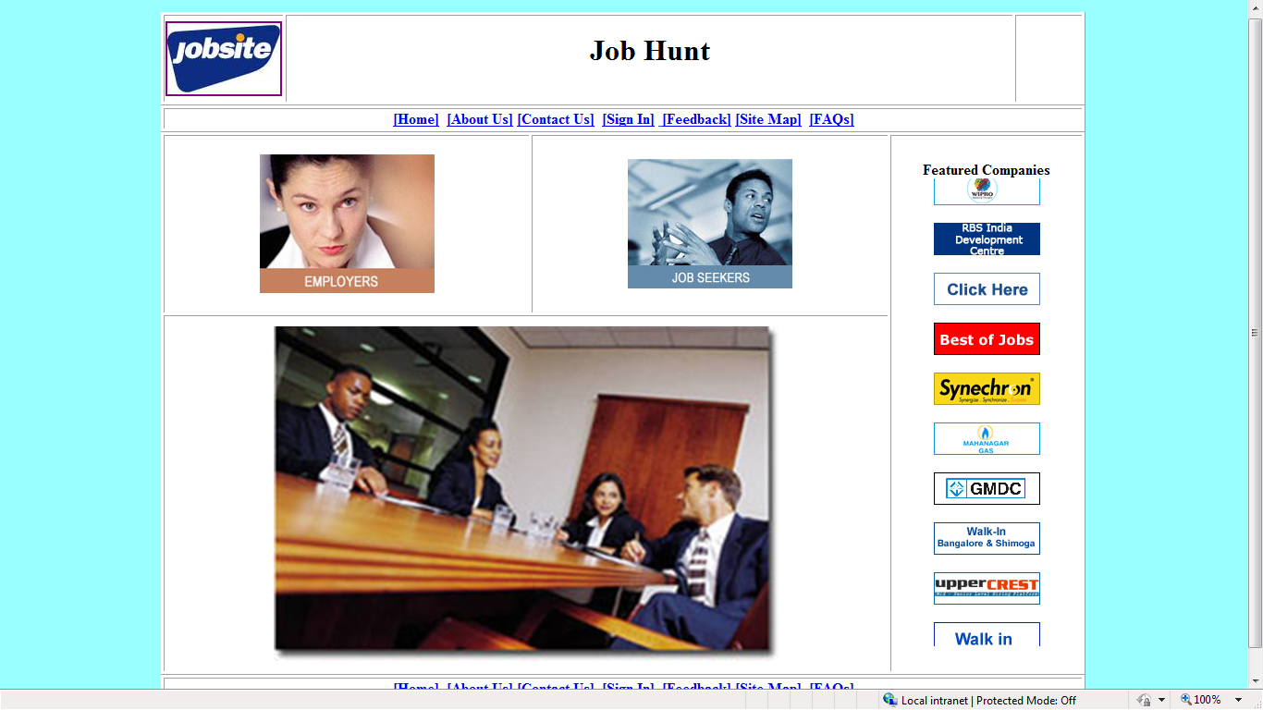
HOME PAGE

Slide 3
Home page is the first page of project. It is the starting page. From the home page we can start the various roots(i.e. visit various pages) of the website or project. Basically pages whom we visit from Home Page are following:
Job Seeker Login,
Job Seeker Registration,
Job Seeker Forgot Password.
Entering to Recruiter’s Account.
User can search job By different Pathways. Which are Following:
Job Search By Job Sector.
eg:- IT, BPO, Sales etc.
Job Search By Job Location.
eg:- Chandigarh, Delhi etc.
Job Search By Company.
eg:- COLT, DELL, Microsoft etc.
Job Search for All.
eg:- All users can get any type of job from here.

Slide 4
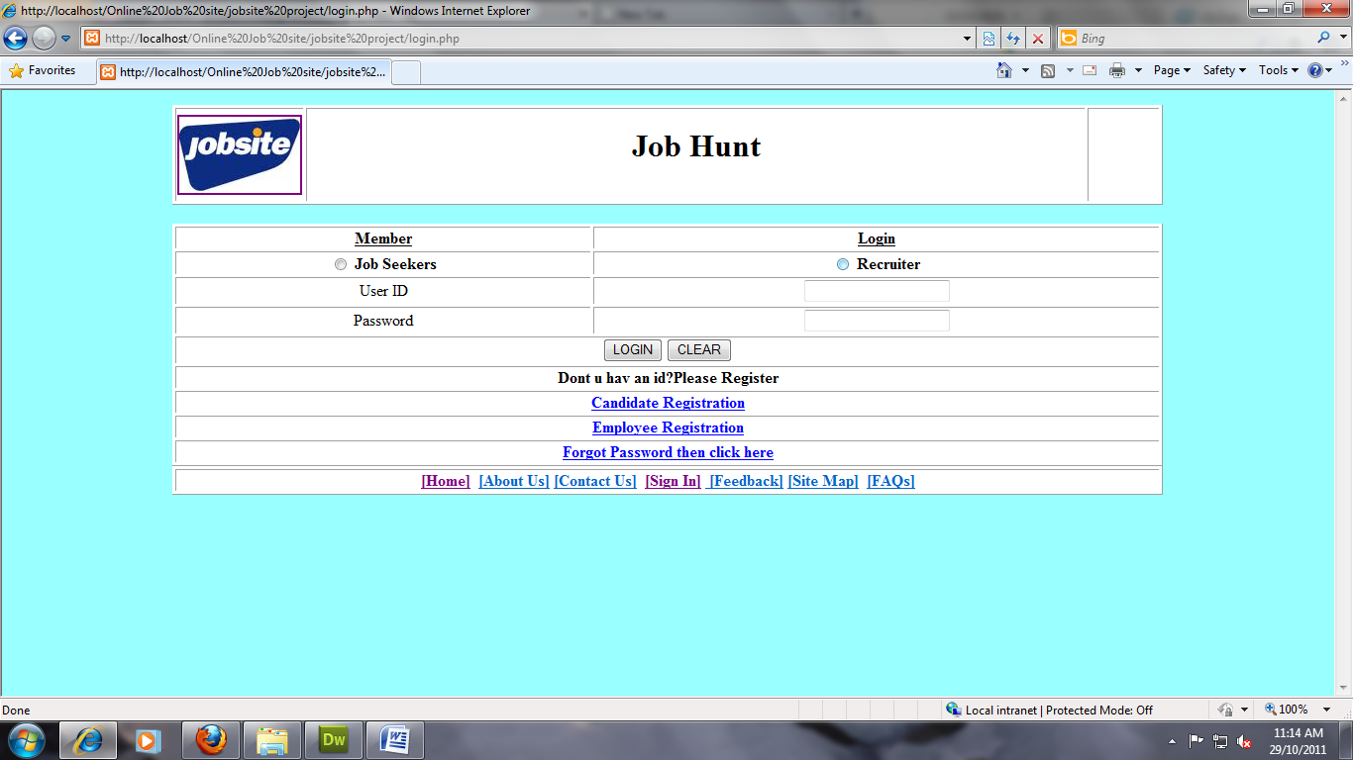
LOGIN PAGE
By entering User ID and Password user can login to the site. Here Job seeker or Employee Can Sign In, if he is an existing member of online job portal otherwise he/she has to sign up .

Slide 5
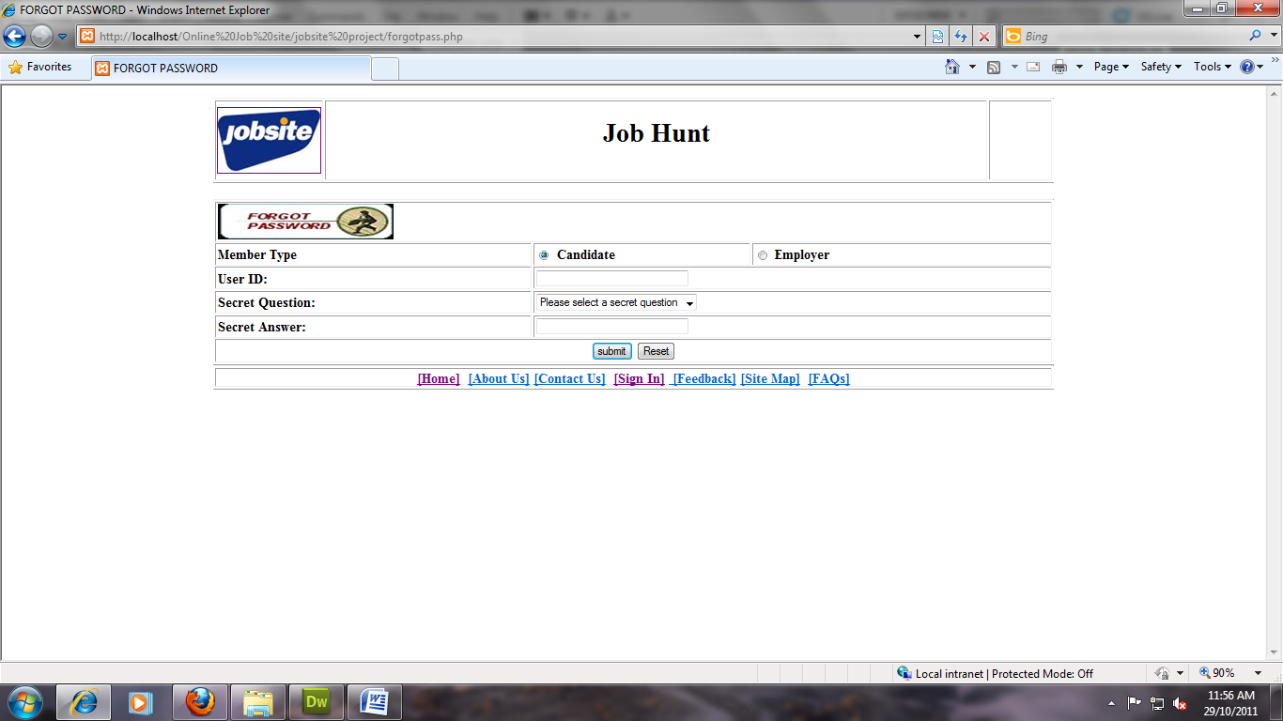
Forgot Password
Job Seeker or Employer can get his/her forgotten Password.

Slide 6
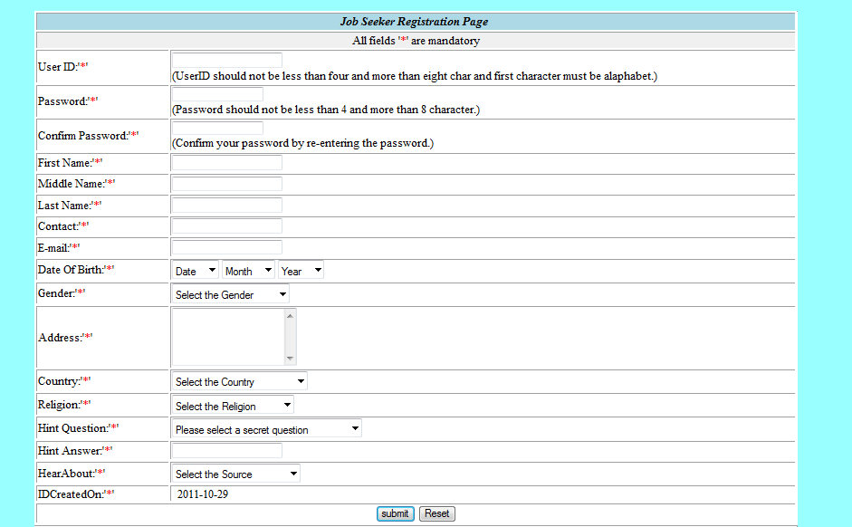
Job Seeker Registration Page
Here new Job seeker Can Sign Up by entering User ID, Password, Name, Contact Number, Email ID,Date of Birth, Address, etc.

Slide 7
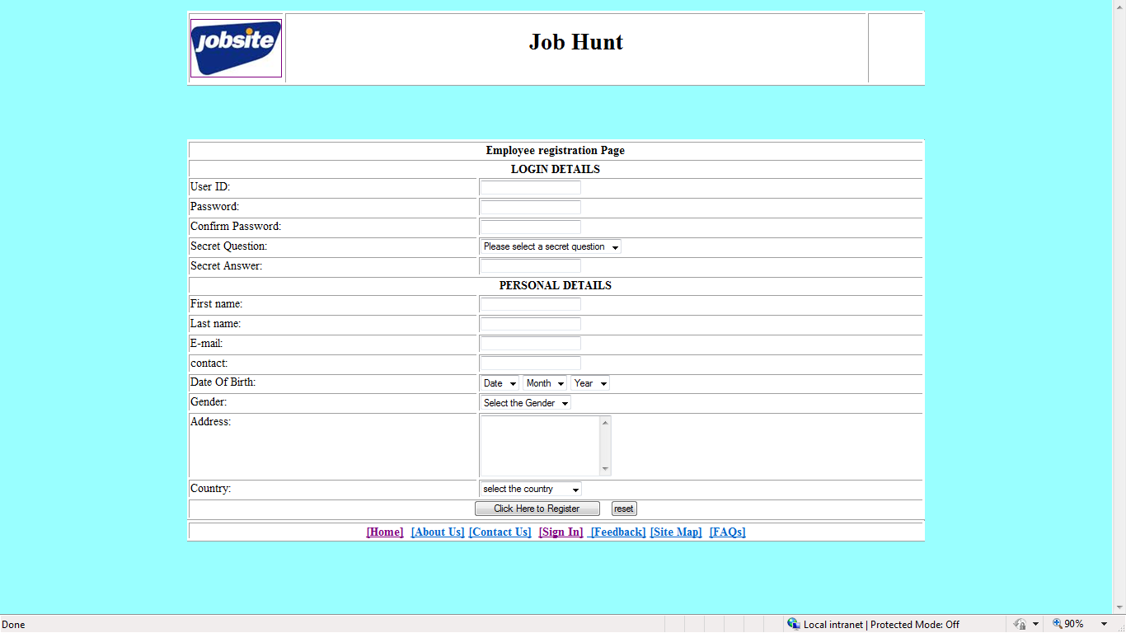
Employee Registration Page
Here Recuiter(Employee) Can register by entering User ID, Password, Company Name, Contact Number, Email ID,Date of Birth, Address, etc.

Slide 8
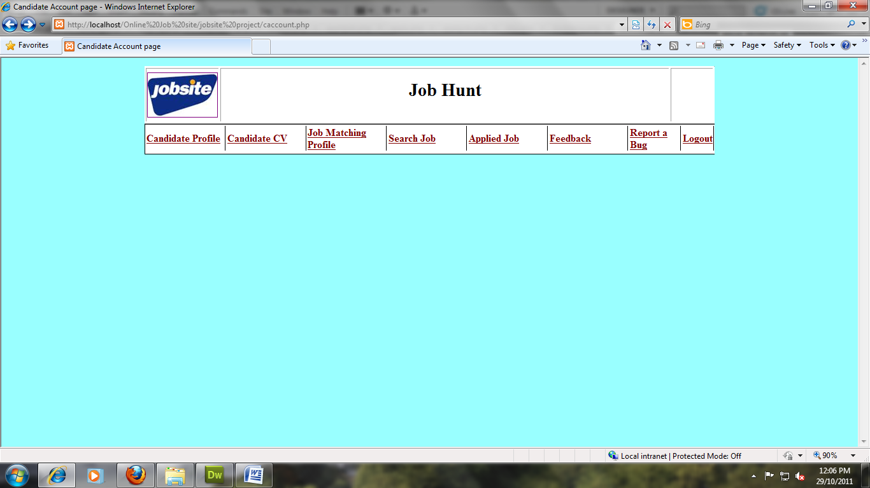
Job Seekers Account
Job Seeker can see the job applications received .
Job Seeker can update Resume.
Job seeker can Preview Resume.
User can create New Resume.
User can update his/her Contacts,
User can change Password.

Slide 9
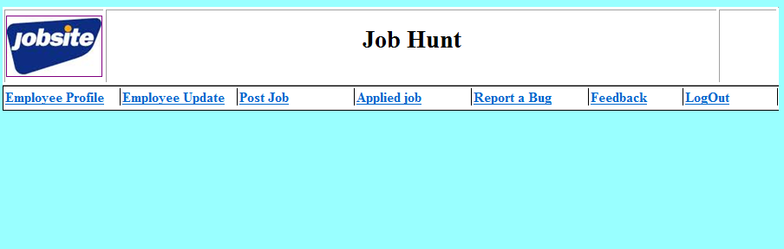
Employee Account
This Employer Account Page, Employer is able to manage his/her account
here, he/she can update job information etc. many other pages are also attached with this. ItContains following features:
Update Contact details, company details.
Post New Job’s.
View Job Applications.
Change Password.
Search Fresher (job seekers).
Search Experienced (job seekers).

Slide 10
ER DIAGRAM
Checks
Employee
CV
Checks
Posts
Feedback
Uploads
Submits
Applies
for
Candidate
Job

